Slide 1

MapMyCampus ODU
Team: ODU SWE
Developer: Megan Witherow
Backup: Mary Aman

Slide 2
Application Goal
Directory for students to find the main academic buildings on campus
Way to go about finding friends on campus
Resource for determining if parking is available
Easy way for students to help other students while earning rewards

Slide 3
MapMyCampus Features
Campus Map Application
Earn points
Checking in: 10 pts
Reporting on Parking: 20 pts
Level up
Compete with friends
Points to Rewards Transactions

Slide 4
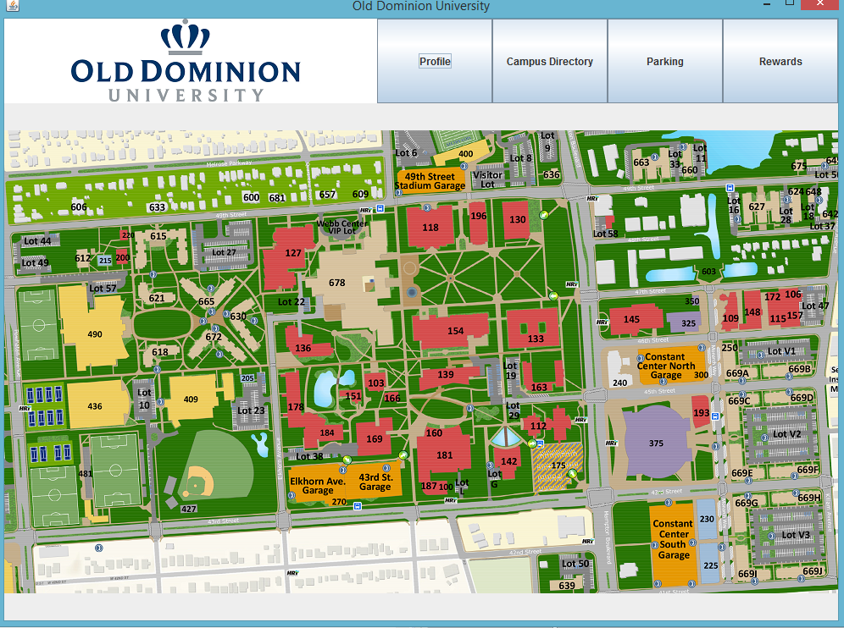
Application Demonstration

Slide 5
Future Features
Interactive map
Mobile Application in addition to desktop
Link to database to connect with other users and retrieve information
Social media connection
Display courses and other events on map
View map with events based on date
Support for calendar applications
Check-in to classes and link to Blackboard
Parking Report Votes from all users are averaged

Slide 6
Thank you!
Questions?

